Slide 1

Identifying Sevengill Sharks in San Diego with Wildbook
Notorynchus cepedianus
(broadnose sevengill shark)
501(c)(3) Nonprofit
        EIN 46-5209246

Slide 2
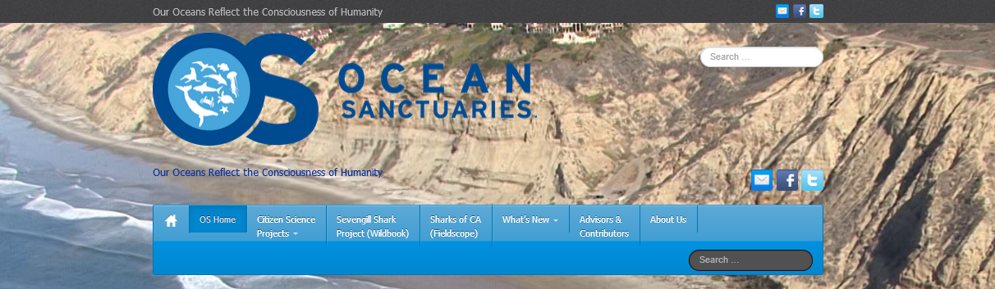
Our Mission
To inspiring ocean-related citizen science
To engage in baseline studies and monitoring
To share data with researchers and scientists
501(c)(3) Nonprofit
POB 26957, San Diego, CA 92196
        EIN 46-5209246

Slide 3
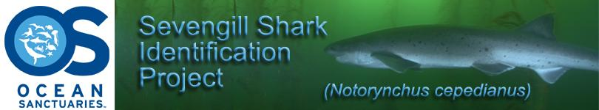
Why Sevengill Sharks?
Why Wildbook?
Sevengill Sharks
  Baseline population study
Wildbook
  Ease of use for citizens
  Online database of crowd-sourced data
  Stores and analyzes for population study
501(c)(3) Nonprofit
POB 26957, San Diego, CA 92196
        EIN 46-5209246

Slide 4
Overview
What is a Sevengill shark
Conservation Status
Research Objectives
Wildbook
Verifiable Encounters
Pattern Recognition
Identifying Individuals
What’s next
501(c)(3) Nonprofit
POB 26957, San Diego, CA 92196
        EIN 46-5209246

Slide 5
Biology, Range & Habitat
Large seven-gilled shark
  Wide head, short and blunt nose
  Only species in its genus
Diet: other sharks, bony fish, seals and carrion
Wide ranging, mostly temperate coastal seas worldwide
  Prefers rocky bottom habitats
  Inshore: Bays and estuaries
  Adults: offshore and deep channels in bays
501(c)(3) Nonprofit
POB 26957, San Diego, CA 92196
        EIN 46-5209246

Slide 6
Behavior
Travel in groups; solitary as well
Attacks at great speeds
Nocturnal and turbid waters
Cruise slowly near bottom
  even in waters as shallow as a meter
  sometimes at the surface
Success as an apex predator
  attributed to feeding strategies
  often over-looked as an important apex marine predator
501(c)(3) Nonprofit
POB 26957, San Diego, CA 92196
        EIN 46-5209246

Slide 7
Conservation Status
Currently: "Near Threatened" in the
eastern Pacific Ocean.
IUCN lists the Sevengill shark as “Data Deficient”
  2005 shark status survey (Fowler et al. 2005)
  Data lacking in most regions
  Difficult to determine overall status of this species
Protection, fisheries management: None
  although it occurs in at least one marine reserve in South Africa
501(c)(3) Nonprofit
POB 26957, San Diego, CA 92196
        EIN 46-5209246

Slide 8
Research Objectives
Does an individual shark return
annually to San Diego?
What months are they seen locally?
We have been unable to find any baseline population studies for this species in the San Diego area, therefore decided to conduct one of our own
Insufficient data to date to draw any conclusions
501(c)(3) Nonprofit
POB 26957, San Diego, CA 92196
        EIN 46-5209246

Slide 9
Wildbook for Sevengill Sharks
A Web-based Application for Wildlife Data Management (Jason Holmberg)
Log photo/video verified encounters
Unique freckling pattern IDs each shark
Identified via pattern recognition algorithm
501(c)(3) Nonprofit
POB 26957, San Diego, CA 92196
        EIN 46-5209246

Slide 10
Pattern Recognition Algorithm
Non-invasive methods of tracking sharks
  Shark tagging was considered invasive
Photo ID process
  Unique freckling pattern
Identifies “Marked Individual”
  Uniquely identified shark
  One or more encounters
501(c)(3) Nonprofit
POB 26957, San Diego, CA 92196
        EIN 46-5209246

Slide 11
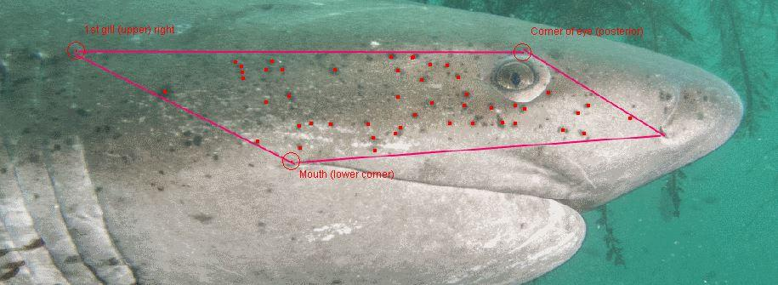
Identifying Individuals
Specific pattern area
Processed by Principal Investigator
Submitted to pattern recognition algorithm
I3S and Modified Groth
501(c)(3) Nonprofit
POB 26957, San Diego, CA 92196
        EIN 46-5209246

Slide 12
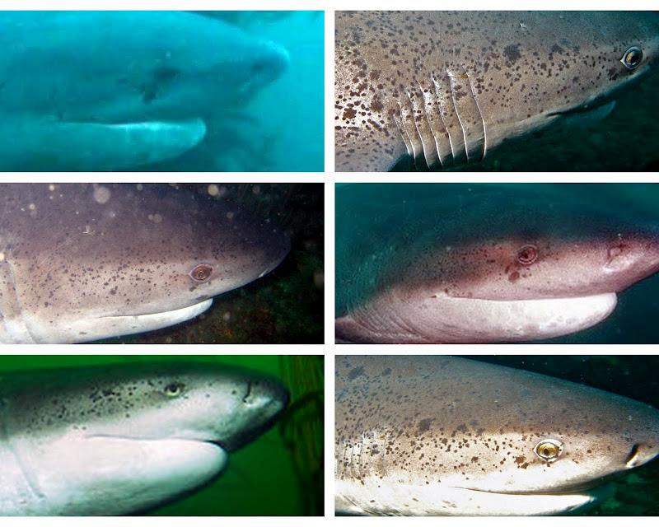
Image Challenges
501(c)(3) Nonprofit
POB 26957, San Diego, CA 92196
        EIN 46-5209246

Slide 13
Photo & Video Encounter
Divers submit high quality image
  GoPro
  DSLR
Image area
  Front, lateral side of the shark
  Left-side and Right-side
Identified individuals can be linked
  Photos submitted to the Wildbook algorithm
  attempt to ID returning sharks from year-to-year
501(c)(3) Nonprofit
POB 26957, San Diego, CA 92196
        EIN 46-5209246

Slide 14
Photo/Video Database
Over 100 photographs
  Used for verifiable encounter
  Used for pattern recognition algorithm
Over 70 videos
  Create still image captures
  Observed behavior
Gender, bite marks, scratches
Taken by volunteer citizen science
SCUBA divers
501(c)(3) Nonprofit
POB 26957, San Diego, CA 92196
        EIN 46-5209246

Slide 15
What Next?
Expand current research goals
Long-term, population dynamics study
(7-10 years)
Publish results in Open Source Journal, such as PLOS One.
501(c)(3) Nonprofit
POB 26957, San Diego, CA 92196
        EIN 46-5209246

Slide 16
Overview
What is a Sevengill shark
Conservation Status
Research Objectives
Wildbook
Verifiable Encounters
Pattern Recognition
Identifying Individuals
What next?
501(c)(3) Nonprofit
POB 26957, San Diego, CA 92196
        EIN 46-5209246

Slide 17
References
Wildbook: A Web-based Application
for Wildlife Data Management
www.wildme.org
Marinebio.org, Sevengill Sharks, Notorynchus cepedianus marinebio.org/sevengillsharks
DA Ebert: South African Journal of Marine Science, 11: 455-465, 1991: Observations on the predatory behaviour of the sevengill shark, Notorynchus cepedianus
IUCN: International Union for Conservation of Nature and Natural Resources (IUCN) Red List of Threatened Species
www.iucnredlist.org/sevengillsharks
501(c)(3) Nonprofit
POB 26957, San Diego, CA 92196
        EIN 46-5209246

